Slide 1
Using the Open Metadata Registry (openMDR) to create Data Sharing Interfaces
October 14th, 2010
David Ervin &
Rakesh Dhaval,
Center for IT Innovations in Healthcare, The Ohio State University Medical Center
Notes:
The template can be used to create presentations for community, civic, advocacy and government relations groups. It is also appropriate for presentations focused on patient education and prevention.

Slide 2
Use Case
Clinical and translational research
Collaborative and team based
Information systems
Locally relevant
Globally interoperable
Institutional Boundaries
Should NOT be boundaries to success and research!
Rapid adoption and deployment
Innovative information integration
Enable the question and answer process

Slide 3
OpenMDR
Semantic Metadata Management Suite
Locally relevant ontology-anchored data elements
Rapid and agile development paradigm
Distributed terminology ecosystem
Federated queries across multiple deployments
Interaction with other semantic management systems
ISO 11179 semantic repository
Integration with industry standard tools

Slide 4
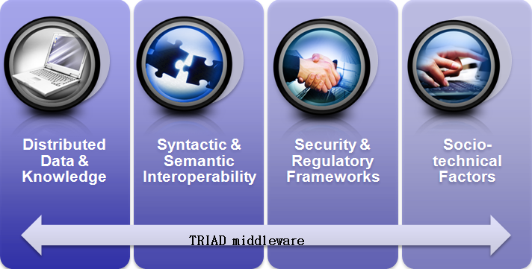
OpenMDR In Context
A component of the TRIAD grid project
Translational Research Informatics and Data management grid
Grid - “Controlled and coordinated resource sharing and problem solving in dynamic, scalable virtual organizations.”
Derived from caBIG’s caGrid – Provides the software infrastructure that underlies tools and applications

Slide 5
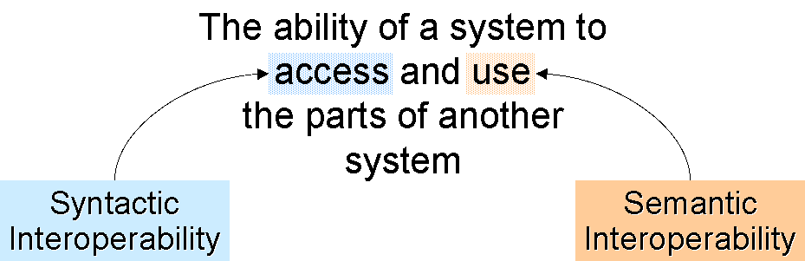
OpenMDR facilitates interoperability
Two phases of interoperability
Existing grid infrastructure gives us syntactic interoperability
OpenMDR facilitates semantic interoperability

Slide 6
Knowledge Engineering Process
Requirements Analysis
Determine needs, stakeholders and conditions to meet for new product or process
Knowledge Acquisition
Transformation of knowledge into a form used by knowledge-based system
Domain and Data Modeling
Conceptual modeling of system describing entities and their relationships
Semantic Annotation
Process of normalizing and standardizing data and models to allow for information exchange

Slide 7
TRIAD Development Process
End-to-end service creation
Begins with modeling and results in an interoperable grid service
Leverages existing tools for rapid application development
Create Semantically Harmonized Data Model | Generate Data Resource | Grid-ify
Create an Information Model using a modeling tool
Perform Semantic Integration using the
EA Plugin
Transform the Model into Metadata using the Domain Model Gen.
Generate Code and Interfaces using the caCORE SDK Code Generator
Generate a Grid Service using Introduce
Information Models
Vocabularies
CDEs
APIs
Grid

Slide 8
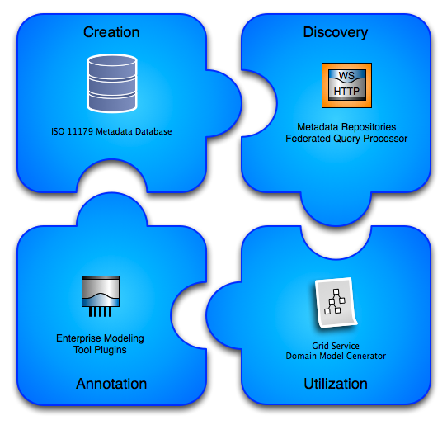
OpenMDR Components

Slide 9
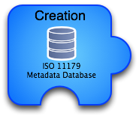
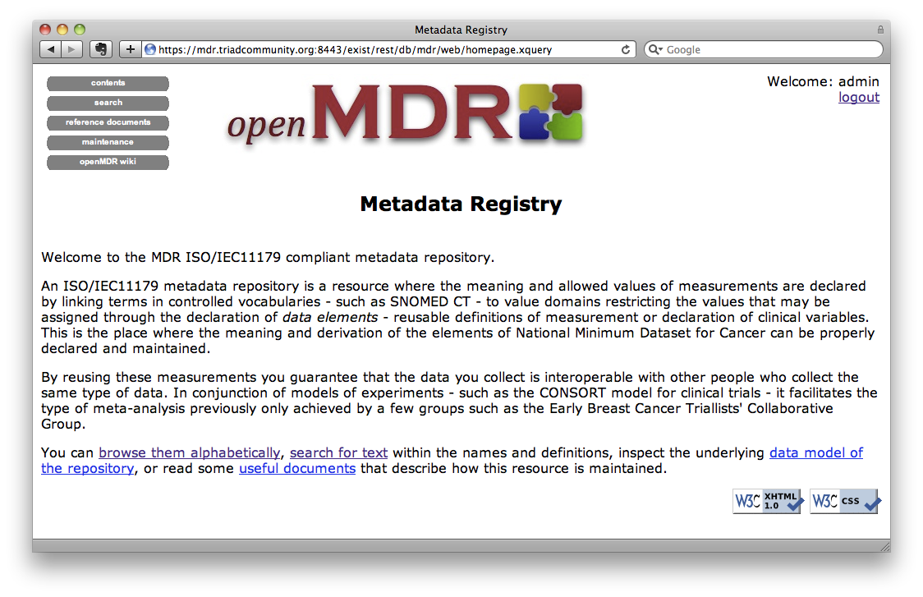
openMDR:mdrCORE
Metadata Registry - Capable of storing, versioning, and maintaining semantic and representational metadata.
Extends and enhances the UK cancergrid cgMDR ISO11179 database.
Built on eXist XML database.
Metadata is annotated with conceptual information from a local or remote lexEVS system(s).
Web based front-end for creating and curating semantic metadata.

Slide 10
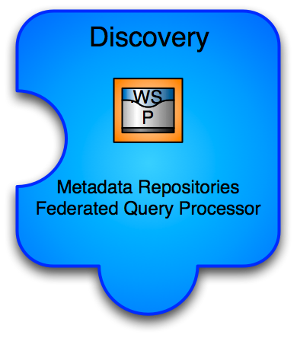
openMDR:mdrQuery
Facilitates discovery of data elements
API and Grid Service for querying across many disparate semantic metadata repositories
caGrid grid service - capable of querying into caDSR and many openMDR systems enabling federated query for common data elements
Enhances and wraps the cgMDR mdrConnector in order to parse the received information into a common format
caGrid service enables it to be deployed in any local or production grid environment and can be configured and modified to query into many semantic metadata systems

Slide 11

openMDR:mdrEAPlugin
Semantic Annotation Tool
Enables semantic annotation of federated semantics
Utilizes MDRQuery service for locating and utilizing CDE’s from multiple semantic metadata sources
Options for Search Filters
Enables Search within “Context”
Tags are created that identify CDE via local unique id
Integration into Enterprise Architect
Streamlined, one-tool modeling process

Slide 12
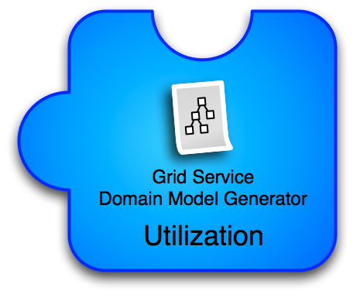
openMDR:mdrDomainModelGenerator
Entry point into existing grid tools chain
Processes a model annotated with the MDR EA Plugin
Creates the service metadata document which describes the data model and semantic annotations on it.
The model is published and is searchable, facilitating discovery and interoperability
The metadata can be used to generate a data service using the Introduce Data Service Wizard

Slide 13
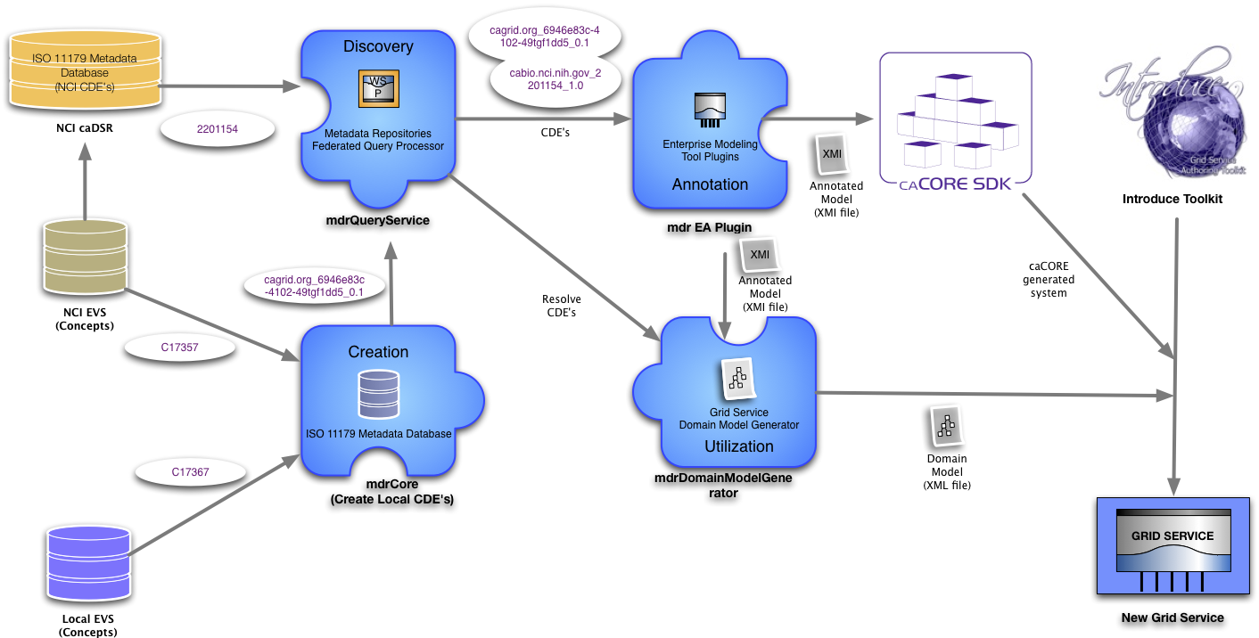
OpenMDR and TRIAD service creation

Slide 14
Future Developments
OpenMDR 1.0 available now!
OpenMDR 1.1 under development
Anticipated release within a month
New features include
Model storage, versioning, retrieval
UI usability enhancements
Bulk loader tools

Slide 15
Further Reading
TRIAD
General interest: http://triadcommunity.org
Technical information: http://wiki.triadcommunity.org
OpenMDR:
http://cagrid.org/display/mdr
Center for IT Innovations in Healthcare (CITIH):
http://citih.osumc.edu

Slide 16

Questions/Comments?
Thank you for your time and attention

